Slide 1
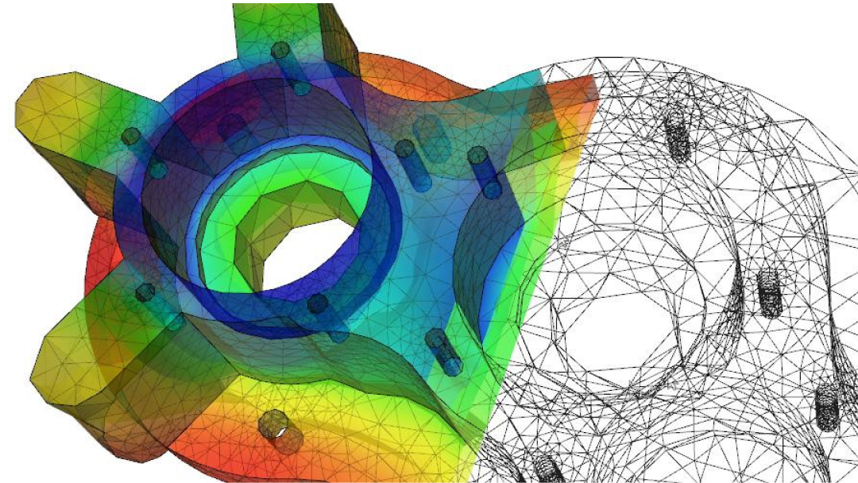
Differential Equation and its Classification
Nazmul Kader Chowdhury

Slide 2
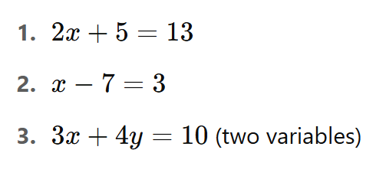
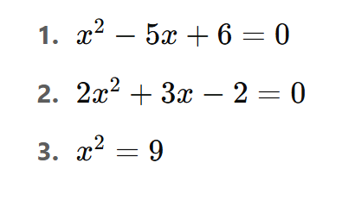
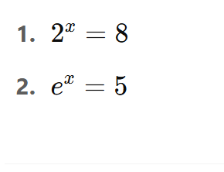
What is Equation?
An equation is a mathematical statement that shows two expressions are equal. It always contains an equals sign (=).

Slide 3
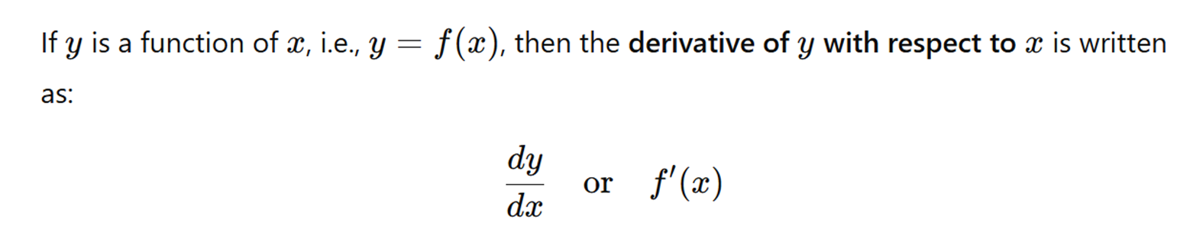
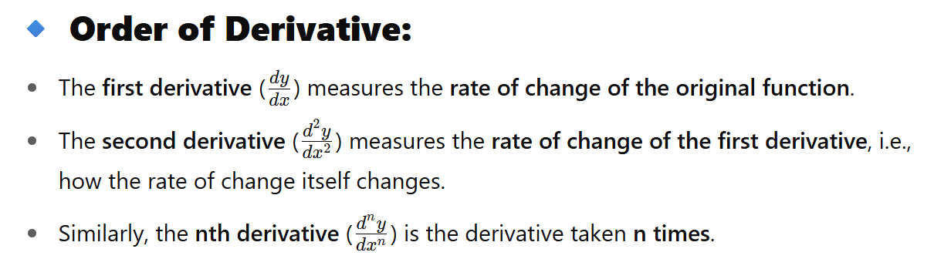
What is Derivative?

Slide 4


What is Differential Equation?
A differential equation is an equation that involves a function and its derivatives.
What is Derivative? Can you remember it?
What is variable? remember
Example:
$\frac{∂^{2}U}{∂x^{2}}+\frac{∂^{2}U}{∂x∂y}+\frac{∂^{2}U}{∂y^{2}}$ = cosx
$\frac{d^{3}y}{dx^{3}}+7\frac{d^{2}x}{dx^{2}}+8\frac{dy}{dx} −$9y = logx
$$\frac{dY}{dx}+\frac{d^{2}Y}{dx^{2}}=sinx$$

Slide 5
Types of Differential Equations
Differential equations are mainly classified into two broad types:
1/ Ordinary Differential Equation (ODE)
2/ Partial Differential Equation(PDE)
Differential Equation
ODE
PDE

Slide 6
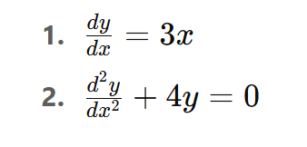
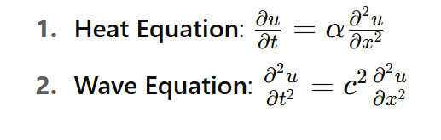
What is PDE?
What is ODE?
Partial Differential Equations (PDE)
Involves two or more independent variables
Uses partial derivatives (denoted by ∂)
Function depends on multiple variables
Ordinary Differential Equations (ODE)
Contains one independent variable
Derivatives are ordinary derivatives
Function depends only on a single variable

Slide 7
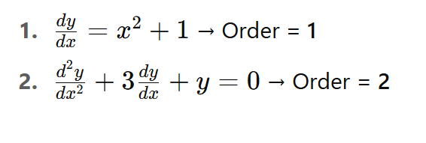
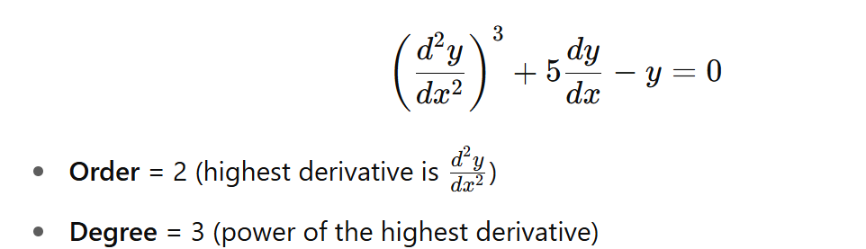
Degree and Order Of ODE
Order
The degree is the power of the highest derivative, provided the equation is:
Free from radicals (roots), and
Free from fractions involving derivatives
Example:
A. Order of a Differential Equation
The order is the highest derivative present in the equation.
Example:

Slide 8
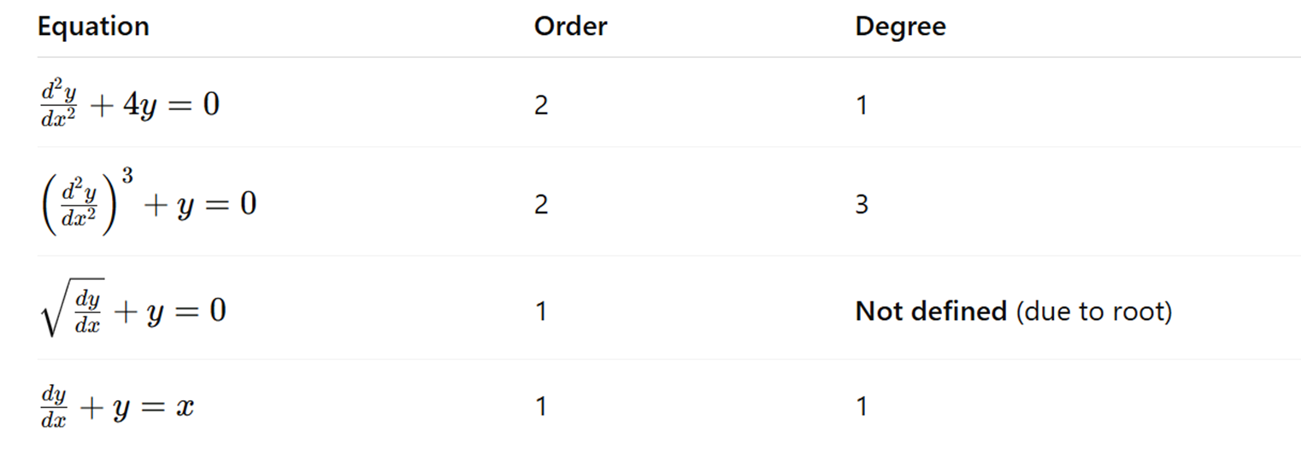
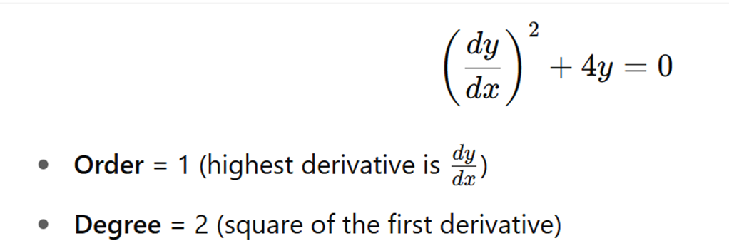


Slide 9
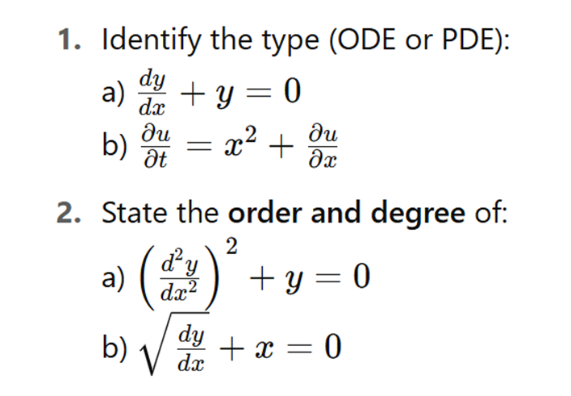
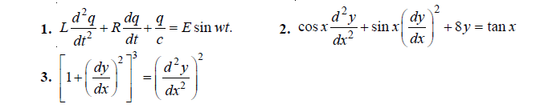

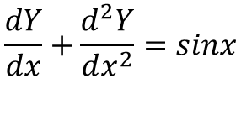
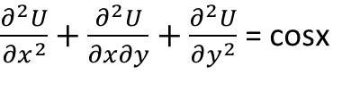


Degree and Order Of ODE
$$\frac{dY}{dx}+\frac{d^{2}Y}{dx^{2}}=sinx$$
$$\frac{dy}{dx}=\frac{1−x^{2}}{2−y^{2}}$$
$\frac{d^{3}y}{dx^{3}}+7\frac{d^{2}x}{dx^{2}}+8\frac{dy}{dx} −$9y = logx
$$\frac{∂z}{∂y}+\frac{∂y}{∂x}=kz$$
$\frac{∂^{2}U}{∂x^{2}}+\frac{∂^{2}U}{∂x∂y}+\frac{∂^{2}U}{∂y^{2}}$ = cosx

Slide 10
